Slide 1
Product Presentation
SKIPPER Electronics AS
Enebakkveien 150
0680 Oslo
www.skipper.no
Tlf. +47 23 30 22 70
Fax +47 23 30 22 71
sales@skipper.no
support@skipper.no

Slide 2
SKIPPER Electronics AS
26 persons in 5 departments
  Administration
  Development
  Support/Service
  Production
  Sales/Marketing
SKIPPER Electronics AS
Enebakkveien 150
0680 Oslo
www.skipper.no
Tlf. +47 23 30 22 70
Fax +47 23 30 22 71
sales@skipper.no
support@skipper.no

Slide 3
Who is SKIPPER?
SKIPPER was established as a brand within SIMRAD in 1973
SKIPPER Electronics become a separate company in 1984
Changed from a trading company to a production company
Today more than 95% is produced by SKIPPER
SKIPPER Electronics AS
Enebakkveien 150
0680 Oslo
www.skipper.no
Tlf. +47 23 30 22 70
Fax +47 23 30 22 71
sales@skipper.no
support@skipper.no

Slide 4
Products
Echosounder for navigation (Newbuildings and retrofit)
Speed Logs (Newbuildings and retrofit)
Echosounder for research
Echosounder for fishing
Special made Echosounders and Speed Logs
Import:
Echosounder and sonar for fishing (Suzuki)
VHF Directionfinders (Taiyo)
Weatherfax (Taiyo)
SKIPPER Electronics AS
Enebakkveien 150
0680 Oslo
www.skipper.no
Tlf. +47 23 30 22 70
Fax +47 23 30 22 71
sales@skipper.no
support@skipper.no

Slide 5

SKIPPER Navigational Echosounders
GDS101
GDS102
Digital repeater for Echosounders
SKIPPER Electronics AS
Enebakkveien 150
0680 Oslo
www.skipper.no
Tlf. +47 23 30 22 70
Fax +47 23 30 22 71
sales@skipper.no
support@skipper.no

Slide 6
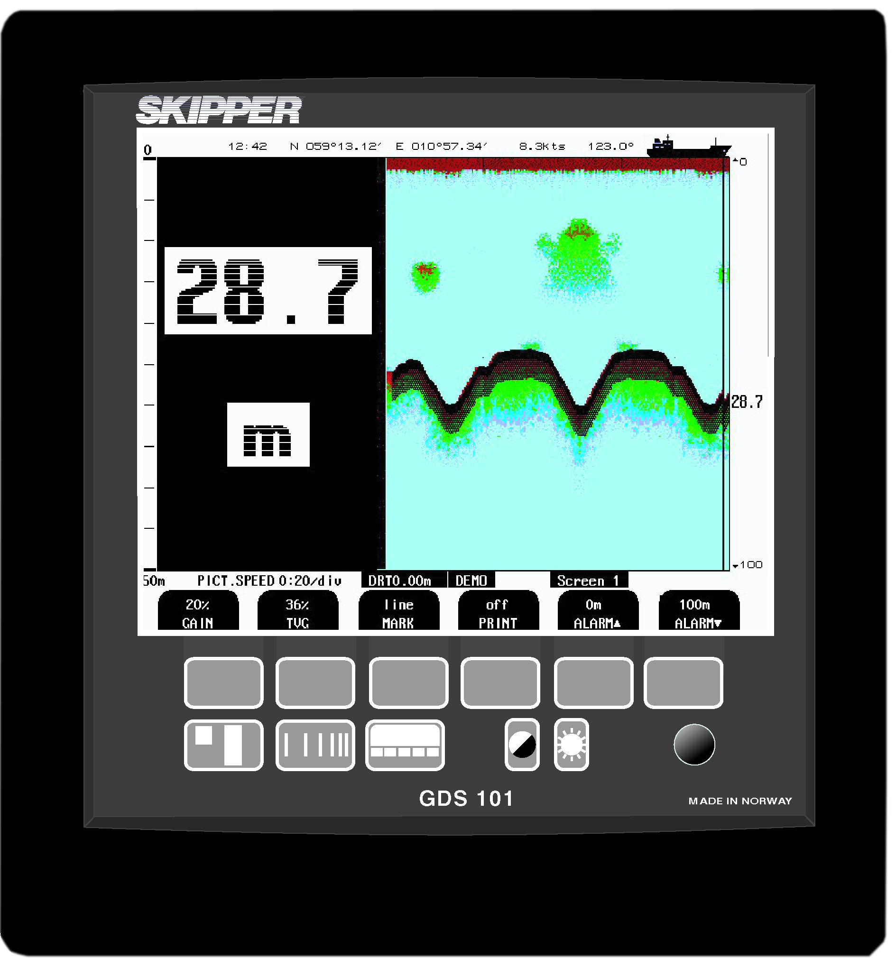
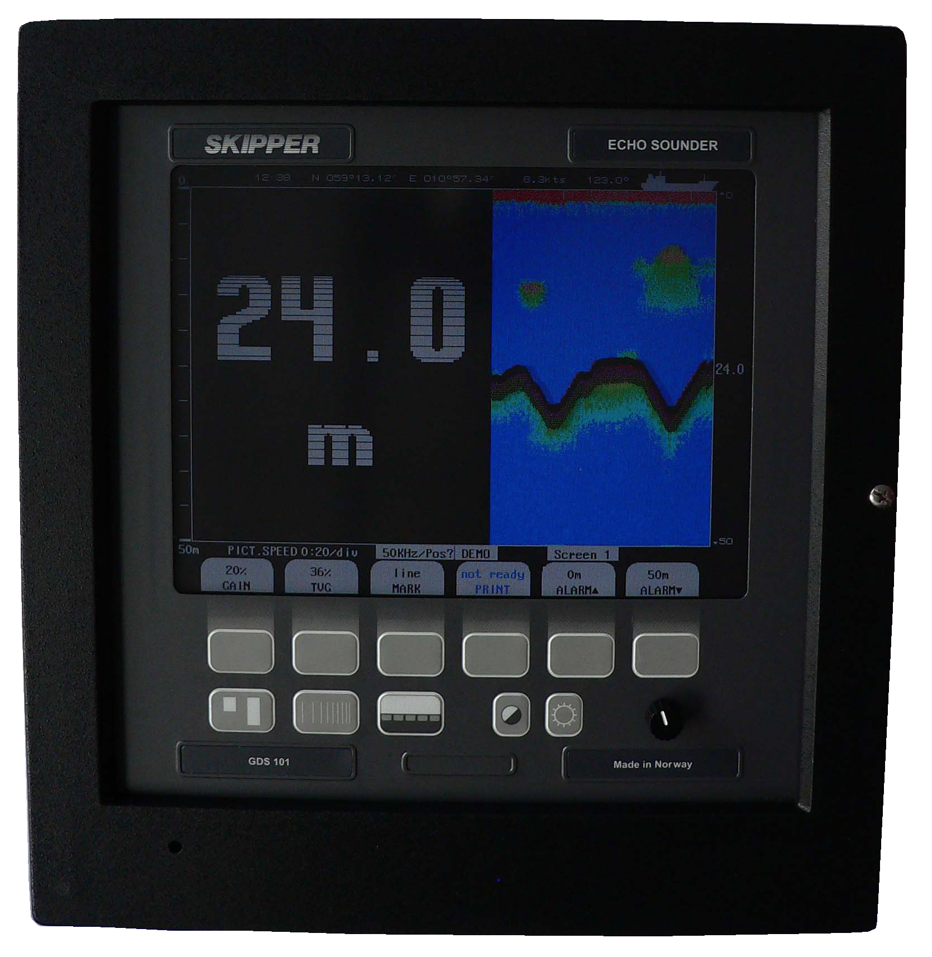
SKIPPER GDS101
38, 50 or 200 kHz
  Other frequencies on request
10,4” LCD Colour screen
Wheelmarked
24 hours memory
NMEA 0183, puls and analogue signals
Alarms
Tank, seavalve for single and double hull mounting
SKIPPER Electronics AS
Enebakkveien 150
0680 Oslo
www.skipper.no
Tlf. +47 23 30 22 70
Fax +47 23 30 22 71
sales@skipper.no
support@skipper.no

Slide 7
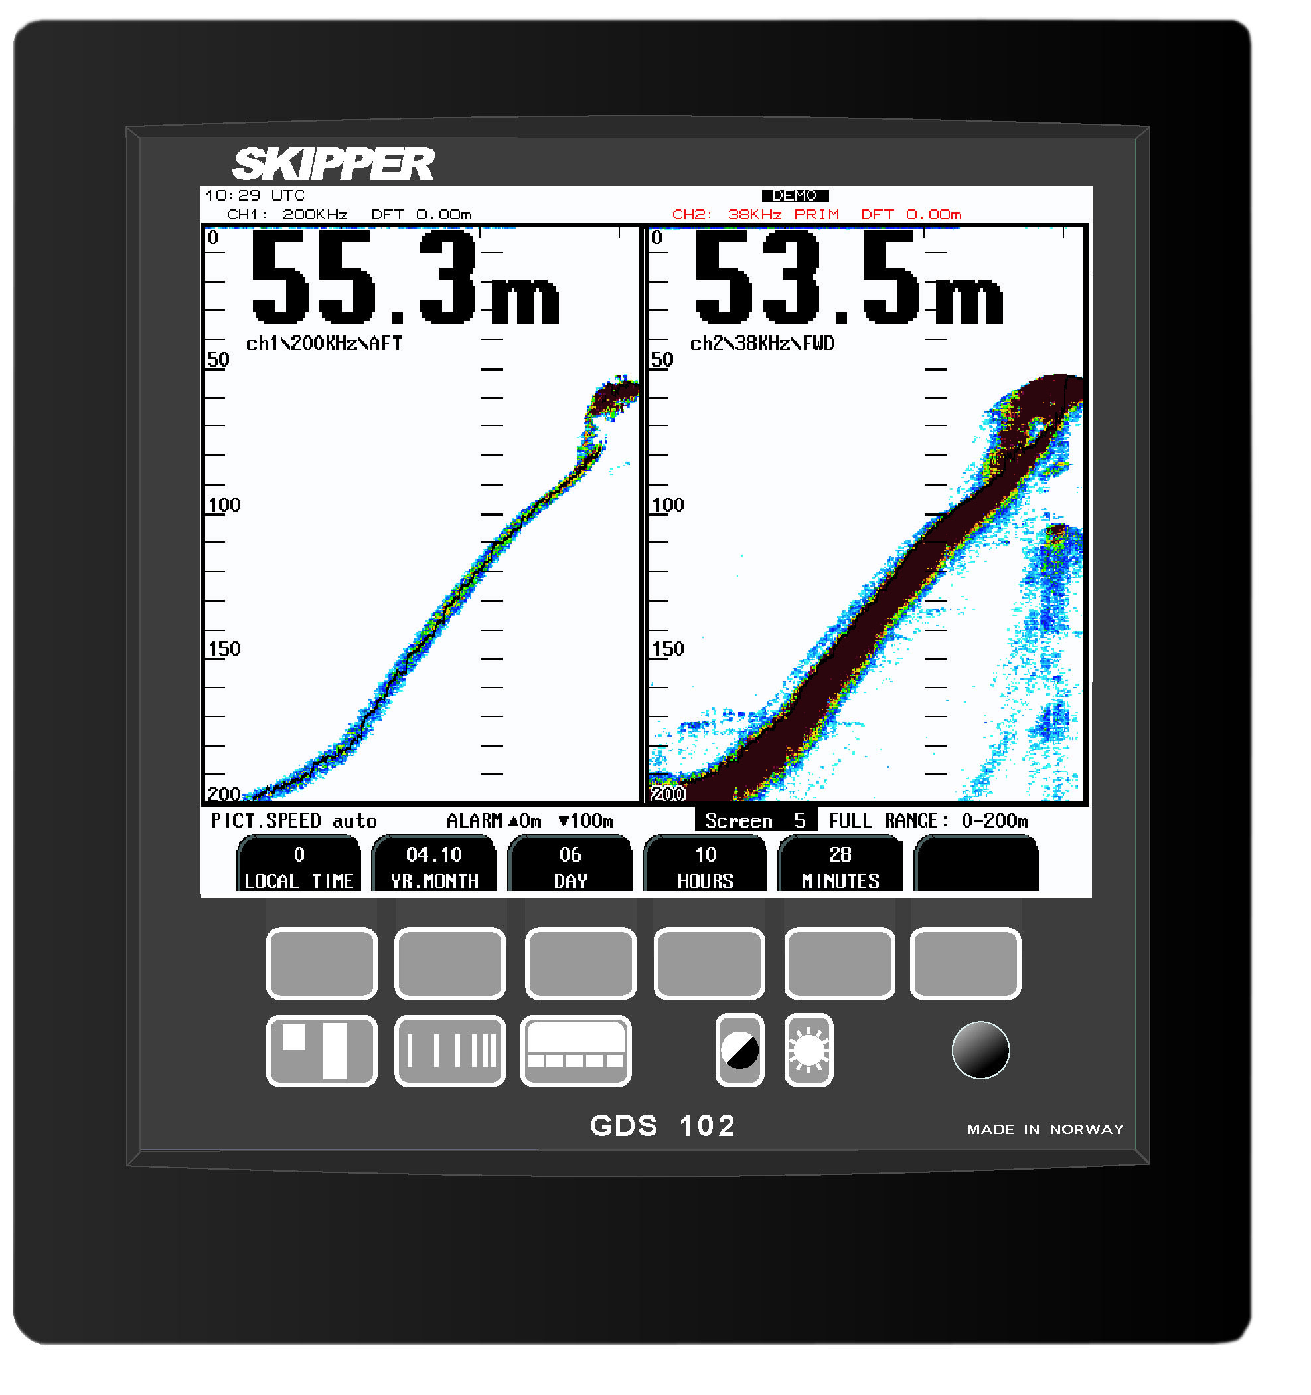
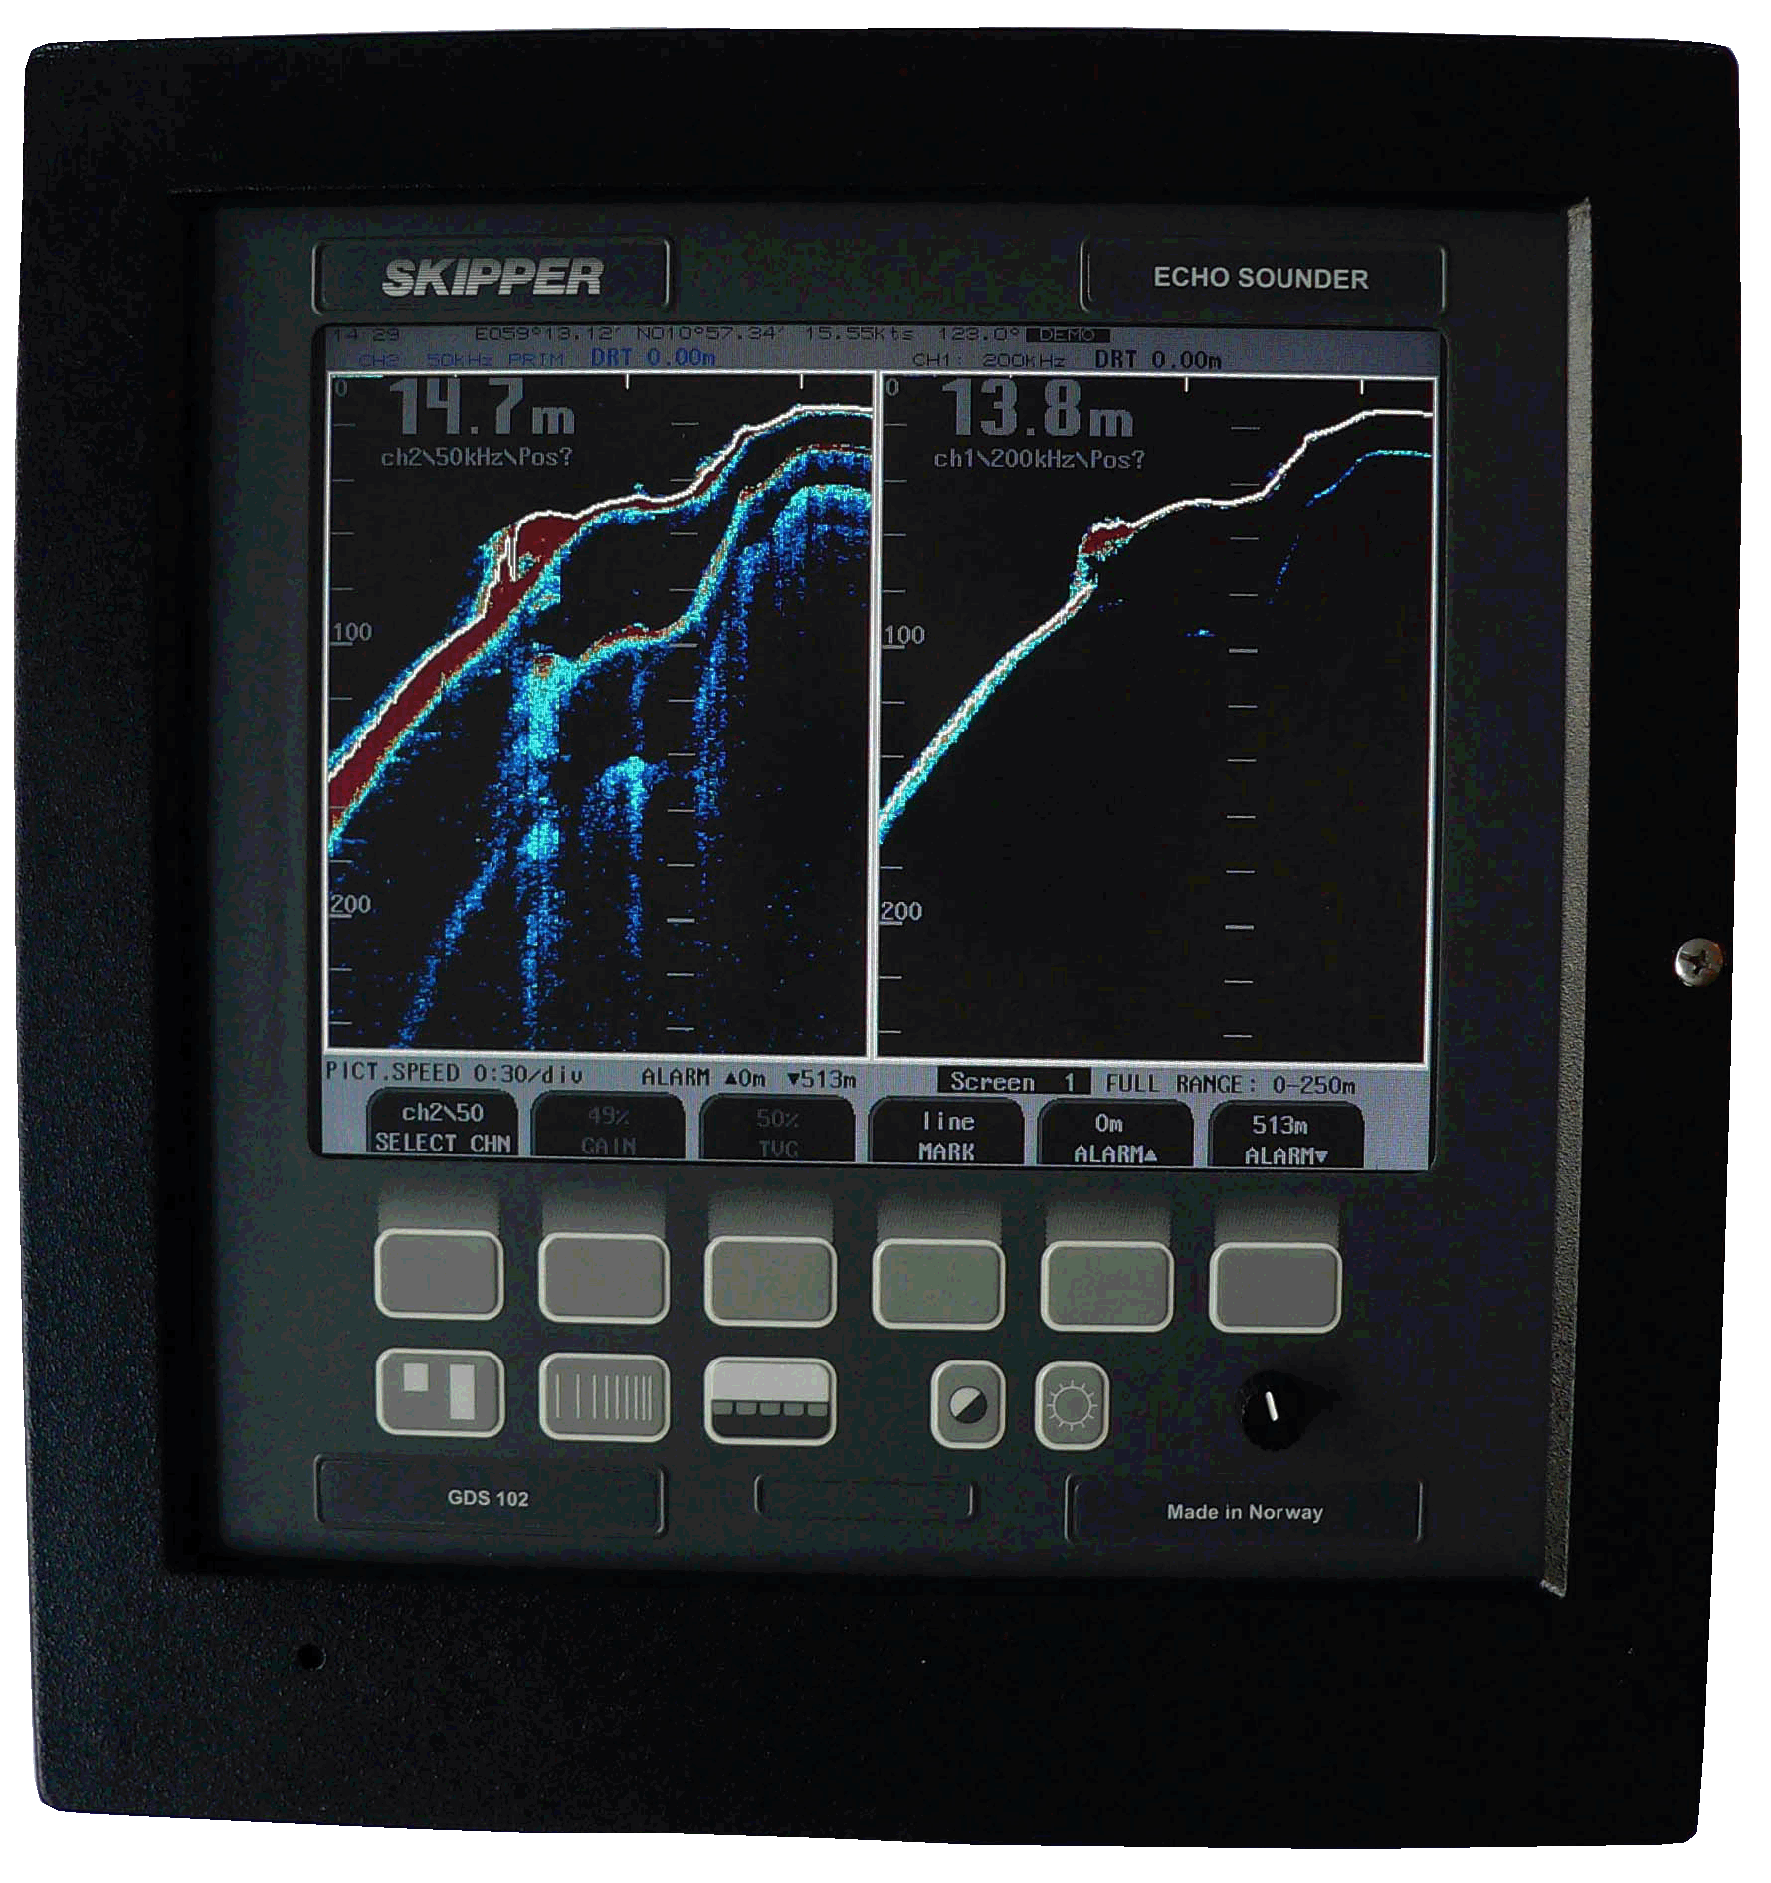
SKIPPER GDS102
10-265kHz
Two channels(10-50 and 50-265kHz)
10,4” LCD Colour screen
Wheelmarked
24 hours memory
NMEA 0183, puls and analogue signals
Alarms
Tank, seavalve for double and single bottom mounting
SKIPPER Electronics AS
Enebakkveien 150
0680 Oslo
www.skipper.no
Tlf. +47 23 30 22 70
Fax +47 23 30 22 71
sales@skipper.no
support@skipper.no

Slide 8
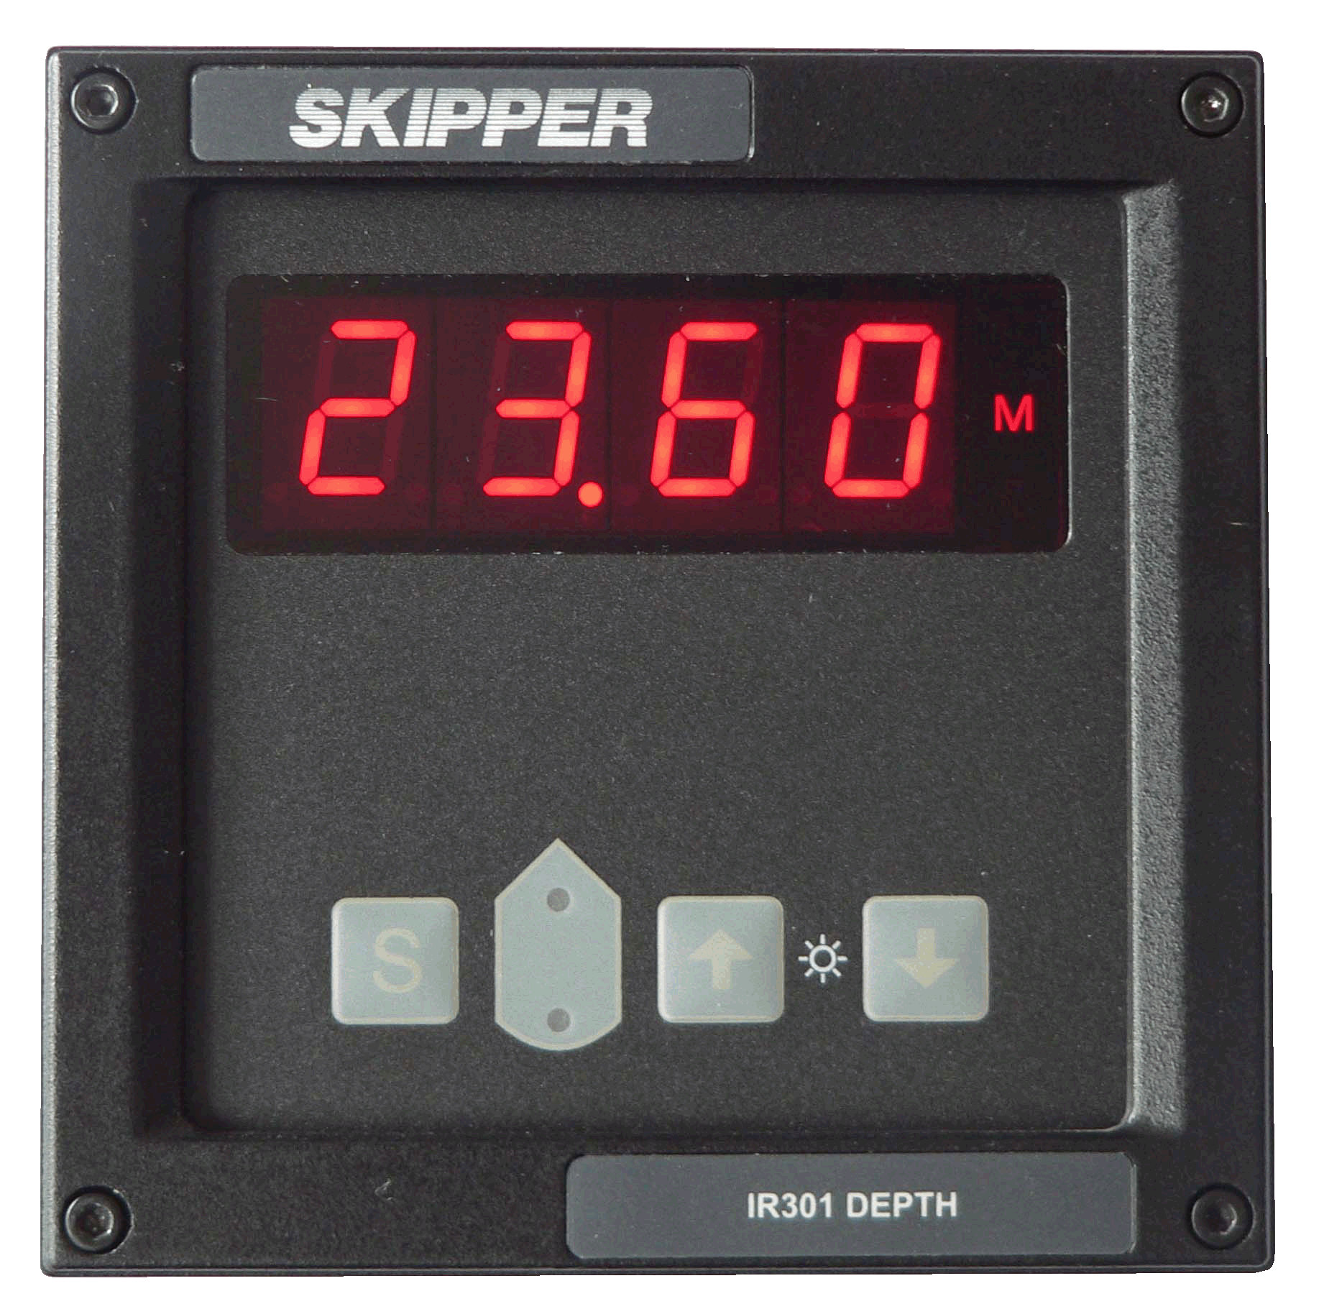

SKIPPER IR301
Digital repeater for Echosounder
NMEA signals
Alarms
Transducer position
Flexible mounting
Extern dimmer
SKIPPER Electronics AS
Enebakkveien 150
0680 Oslo
www.skipper.no
Tlf. +47 23 30 22 70
Fax +47 23 30 22 71
sales@skipper.no
support@skipper.no

Slide 9
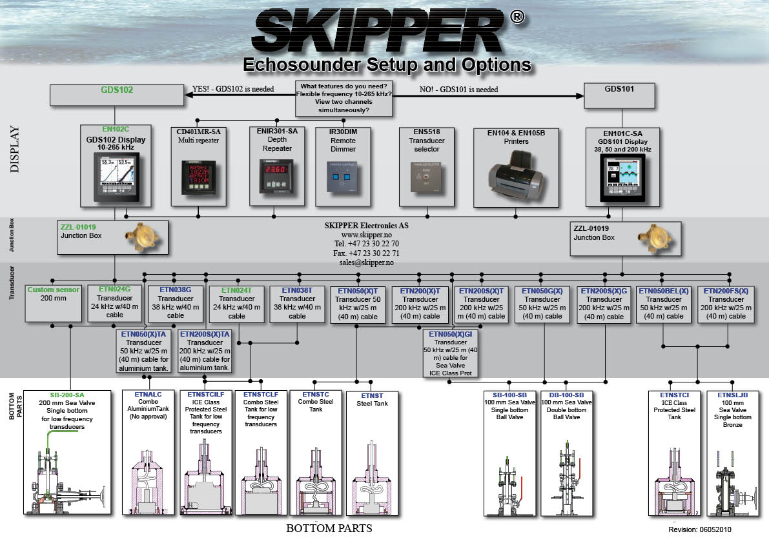

Slide 10
SKIPPER Speed Log
DL21
DL2
DL1 Multi
DL850 270kHz
EML224
EML224 Compact
Digital Speed Log Repeater
Digital Multi Repeater
SKIPPER Electronics AS
Enebakkveien 150
0680 Oslo
www.skipper.no
Tlf. +47 23 30 22 70
Fax +47 23 30 22 71
sales@skipper.no
support@skipper.no

Slide 11
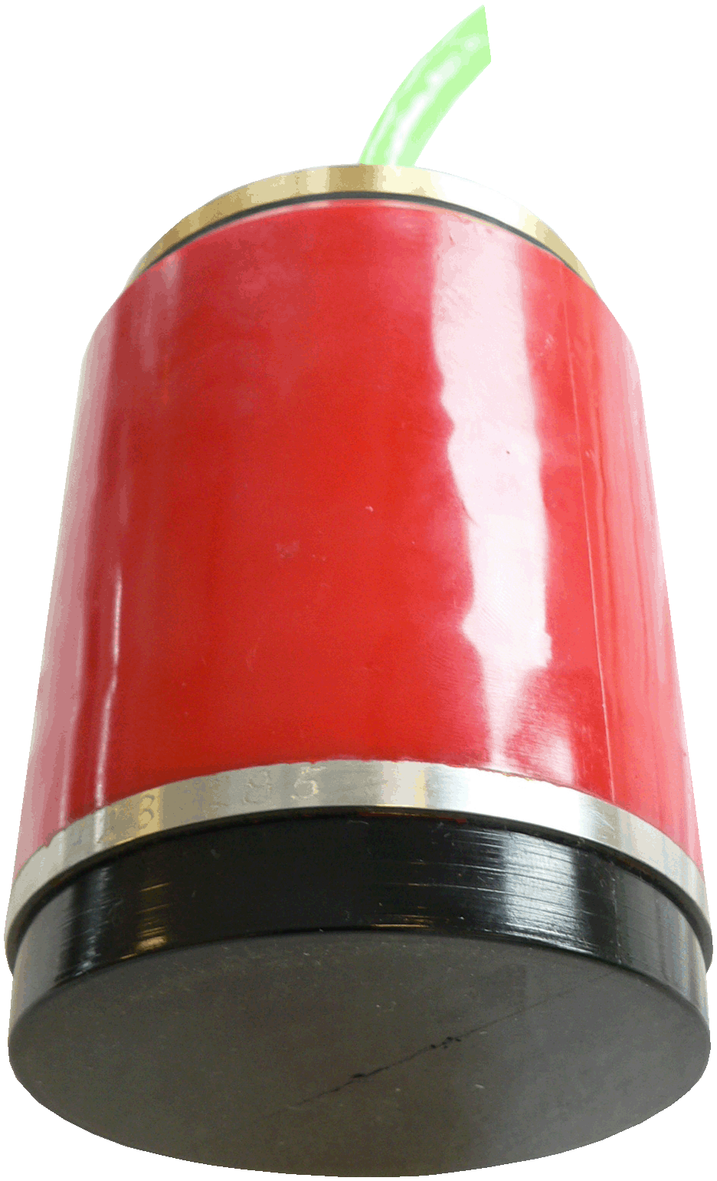
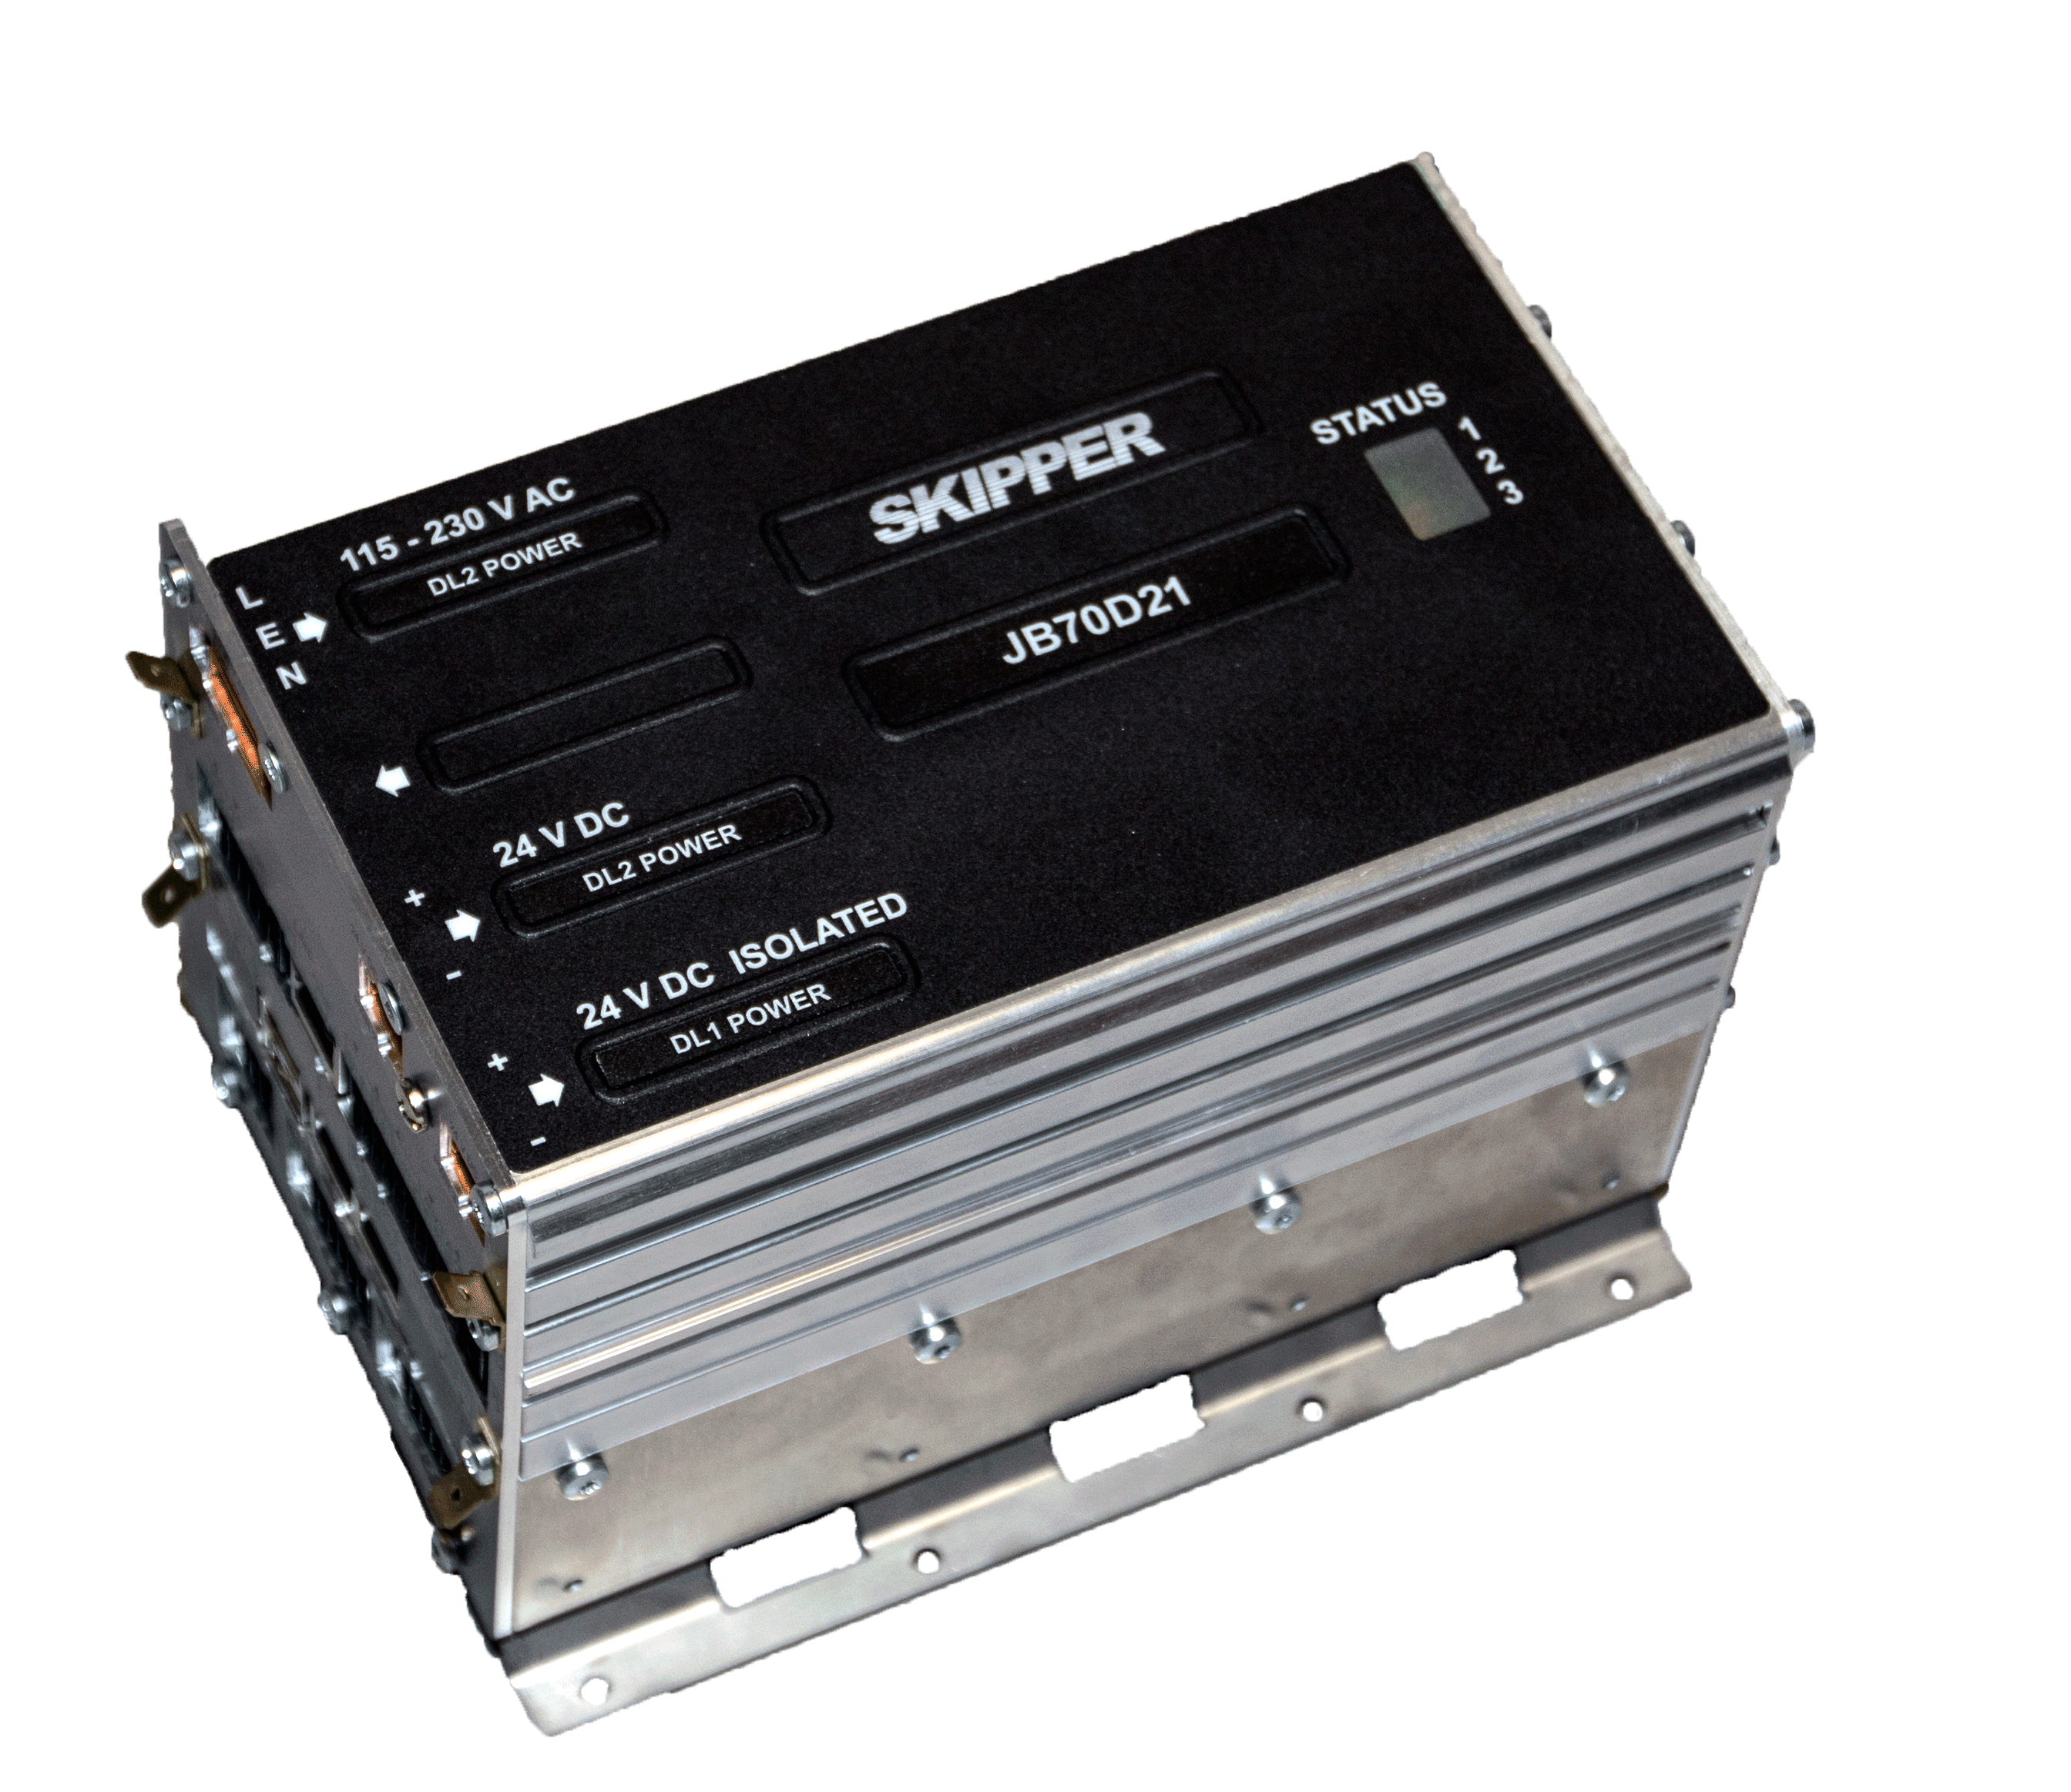
SKIPPER DL21
Doppler Speed Log
Two axis
Separate single axis doppler speed log
Docking function (three axis option)
Speed over ground
Depth readout
Water temperature
LAN, NMEA, puls and analoge signals
9,4” LCD Colour touch screen
SKIPPER Electronics AS
Enebakkveien 150
0680 Oslo
www.skipper.no
Tlf. +47 23 30 22 70
Fax +47 23 30 22 71
sales@skipper.no
support@skipper.no

Slide 12
SKIPPER DL2
Doppler Speed Log
Two axis
Docking function (three axis option)
Speed over ground
Depth readout
Water temperature
LAN, NMEA, puls and analoge signals
9,4” LCD Colour touch screen
SKIPPER Electronics AS
Enebakkveien 150
0680 Oslo
www.skipper.no
Tlf. +47 23 30 22 70
Fax +47 23 30 22 71
sales@skipper.no
support@skipper.no

Slide 13
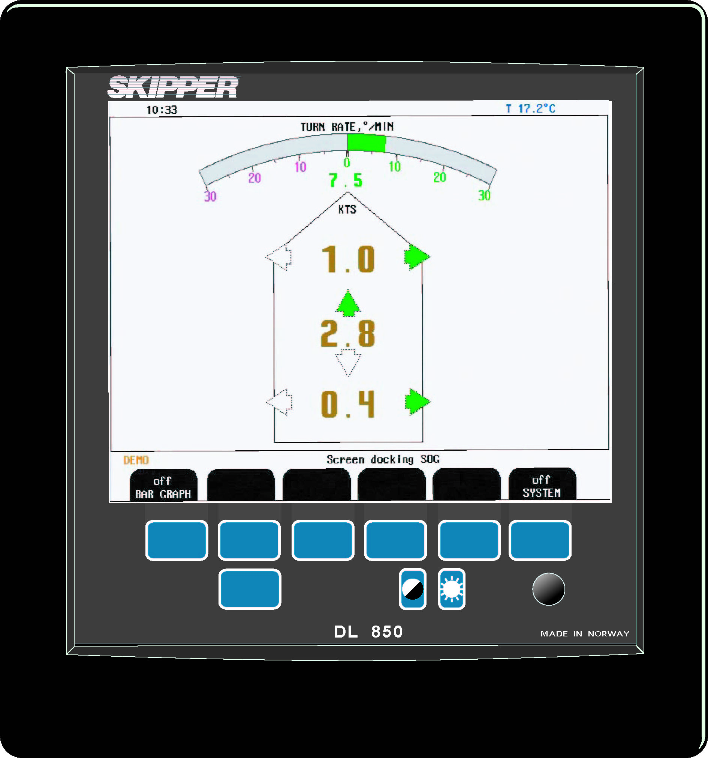
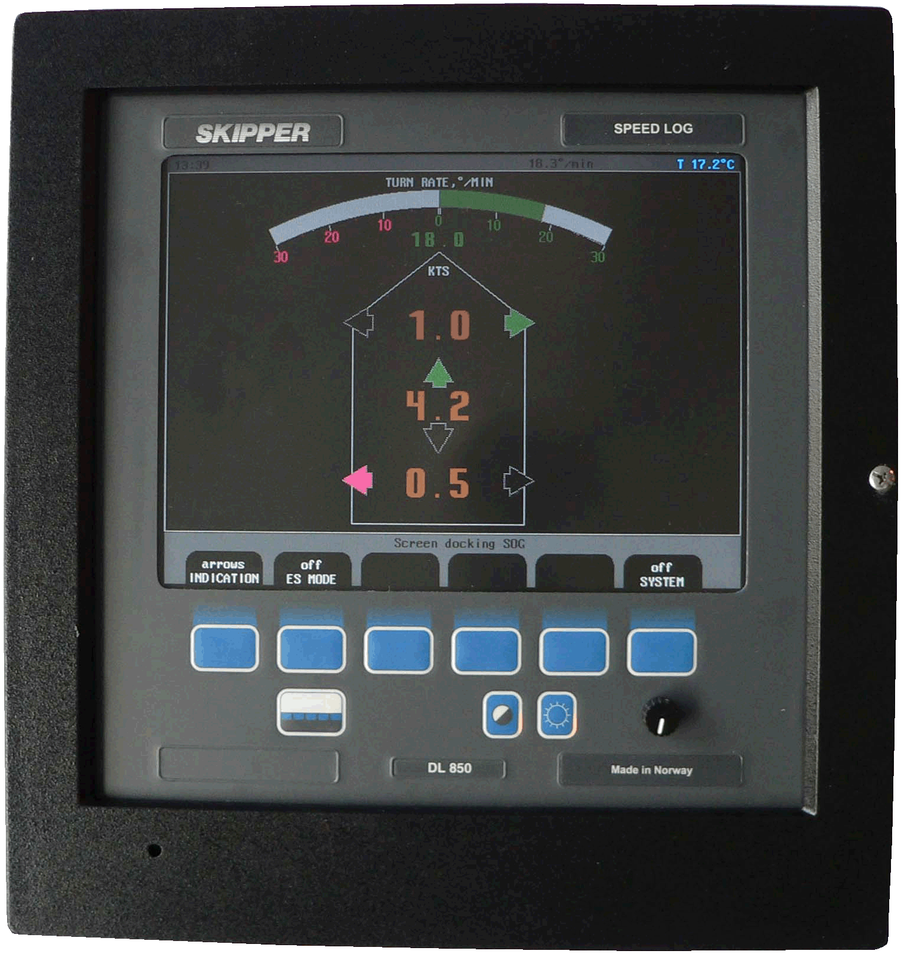
SKIPPER DL850 270kHz
Doppler Speed Log
Two axis
Docking function (three axis option)
Speed over ground (150-200 m)
Depth readout
Water temperature
NMEA, puls and analogue signals
10,4” LCD Colour screen
Tank, seavalve for single and double bottom mounting
SKIPPER Electronics AS
Enebakkveien 150
0680 Oslo
www.skipper.no
Tlf. +47 23 30 22 70
Fax +47 23 30 22 71
sales@skipper.no
support@skipper.no

Slide 14
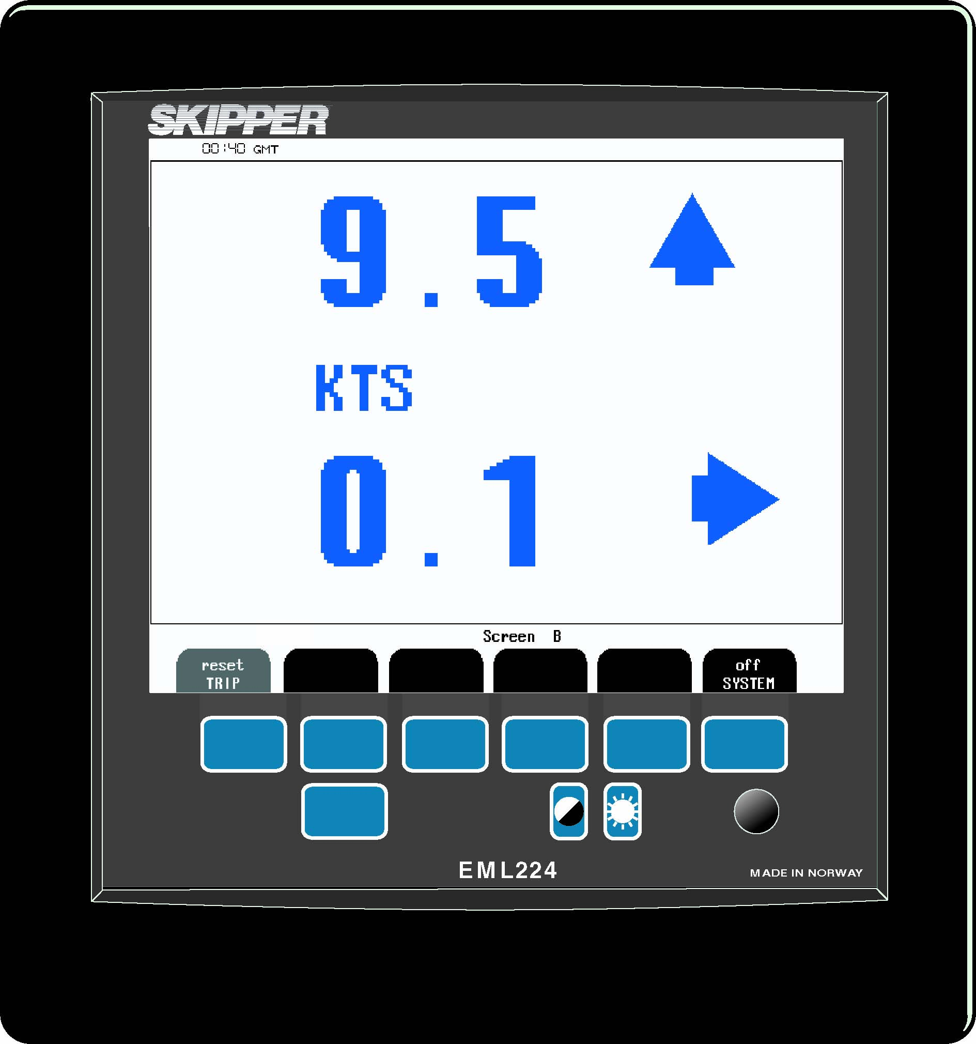
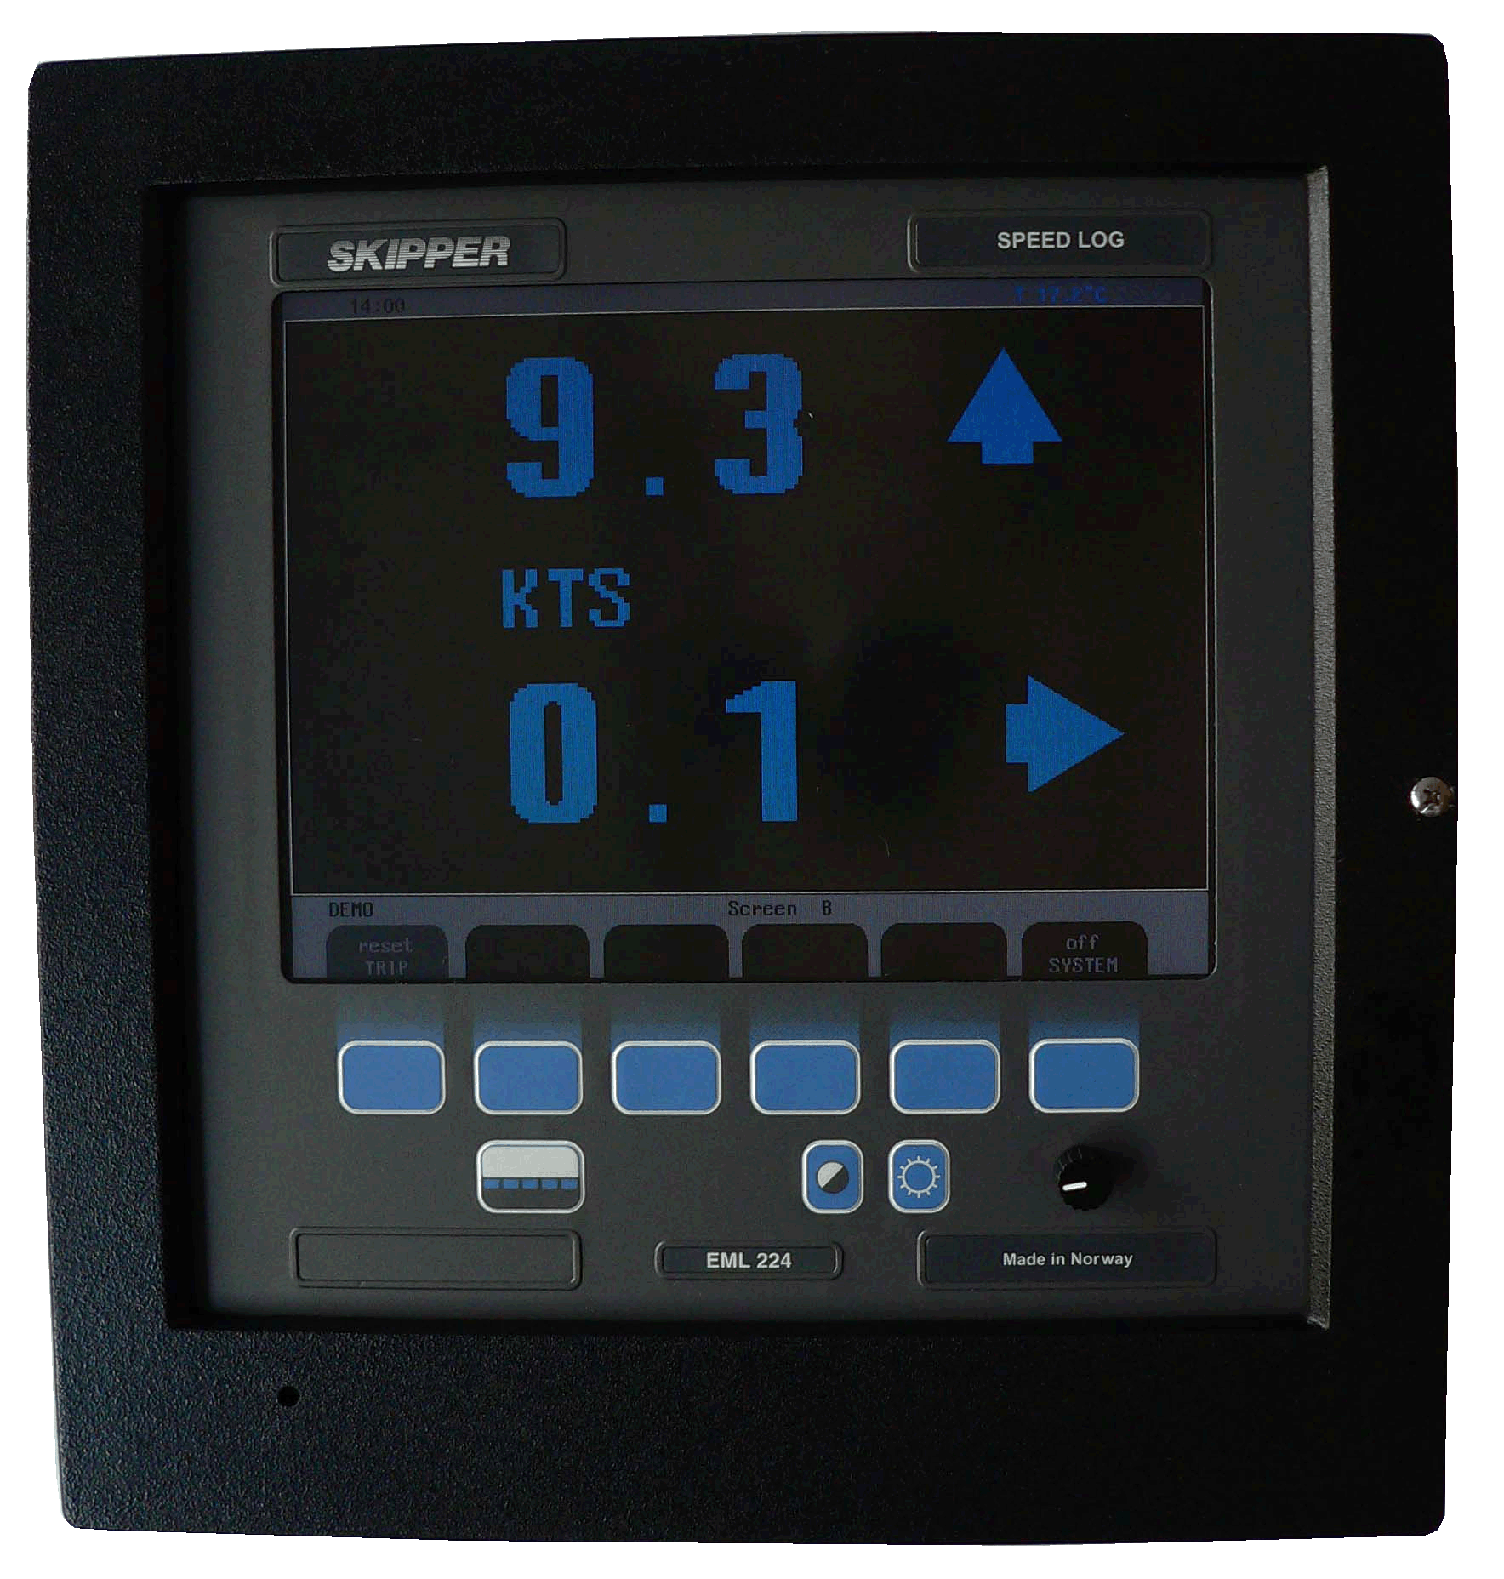
SKIPPER EML224
Electromagnetic Speed Log
Two axis
Water temperature
NMEA, puls and analogue signals
10,4” LCD Colour screen
Tank, seavalve for single and double bottom mounting
SKIPPER Electronics AS
Enebakkveien 150
0680 Oslo
www.skipper.no
Tlf. +47 23 30 22 70
Fax +47 23 30 22 71
sales@skipper.no
support@skipper.no

Slide 15
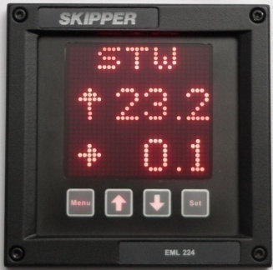
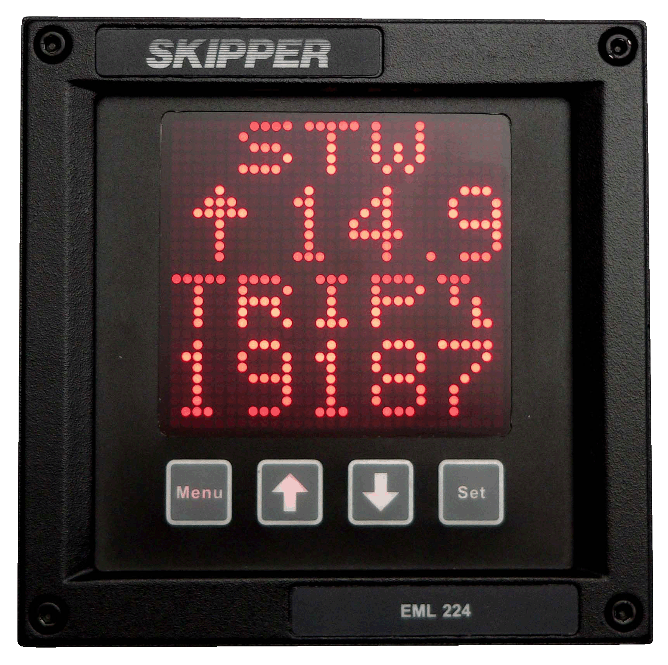
SKIPPER EML224 Compact
Electromagnetic Speed Log
Compact display
  144x144mm
One or two axis Speed Log
Water temperature
NMEA, puls and analogue signals
Tank, seavalve for single and double bottom mounting
SKIPPER Electronics AS
Enebakkveien 150
0680 Oslo
www.skipper.no
Tlf. +47 23 30 22 70
Fax +47 23 30 22 71
sales@skipper.no
support@skipper.no

Slide 16
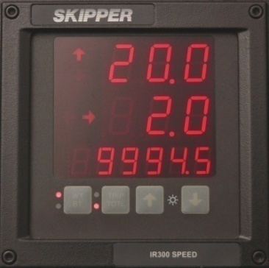
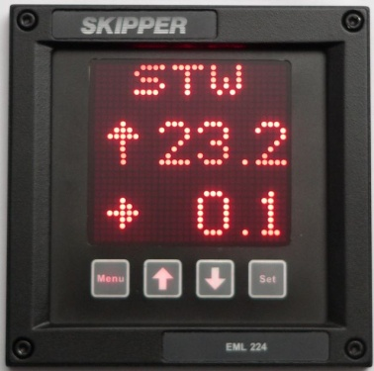
SKIPPER IR300 and CD401
Digital Speed Log repeater
One, two or three axis speed(docking)
NMEA signals
Alarms
Flexible mounting
Trip/total
SKIPPER Electronics AS
Enebakkveien 150
0680 Oslo
www.skipper.no
Tlf. +47 23 30 22 70
Fax +47 23 30 22 71
sales@skipper.no
support@skipper.no

Slide 17
SKIPPER CD401 Multirepeater
• Depth – below surface, keel and transducer
• Speed – over ground and through water
• Distance – total/trip for both groundspeed and waterspeed
• Heading – true, magnetic and relative
• Rotation – rate of turn and direction
• Wind – speed and direction (true, magnetic and relative)
^{• Temp. – water and air}
• Drive – RPM, propeller pitch and rudder position
• Clock – UTC, local time and expected time of arrival
SKIPPER Electronics AS
Enebakkveien 150
0680 Oslo
www.skipper.no
Tlf. +47 23 30 22 70
Fax +47 23 30 22 71
sales@skipper.no
support@skipper.no

Slide 19
Other products for navigation
DGR360 Digital Gyro Repeater
Taiyo 1550 Direction Finder
Taiyo 1630 Direction Finder
Taiyo TF-712 Weather fax
SKIPPER Electronics AS
Enebakkveien 150
0680 Oslo
www.skipper.no
Tlf. +47 23 30 22 70
Fax +47 23 30 22 71
sales@skipper.no
support@skipper.no

Slide 20
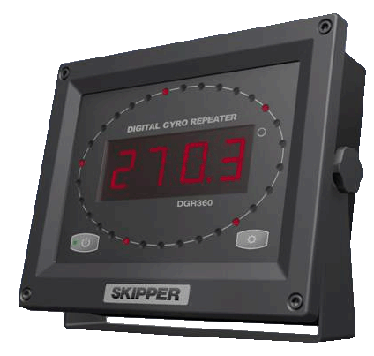
SKIPPER DGR360
Digital gyro repeater
Indication of direction
HDT/THS signals
Flexible mounting
NMEA signals
SKIPPER Electronics AS
Enebakkveien 150
0680 Oslo
www.skipper.no
Tlf. +47 23 30 22 70
Fax +47 23 30 22 71
sales@skipper.no
support@skipper.no

Slide 21
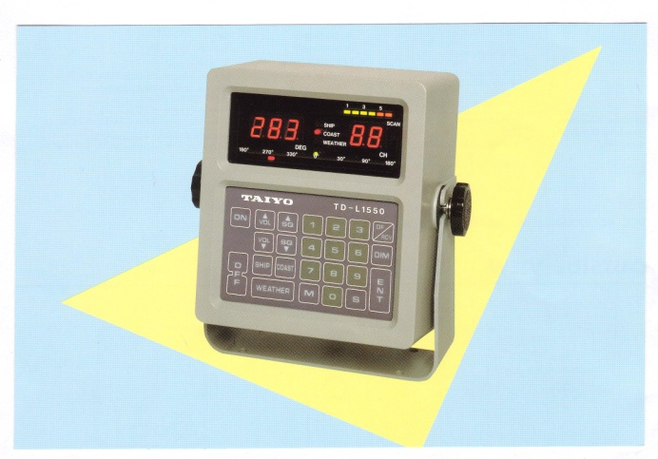
TAIYO Direction finder 1550
Compact
Digital readout
All VHF channels and 121,5MHz
Automatic scanning
User friendly
Included16m cable and antenna
SKIPPER Electronics AS
Enebakkveien 150
0680 Oslo
www.skipper.no
Tlf. +47 23 30 22 70
Fax +47 23 30 22 71
sales@skipper.no
support@skipper.no

Slide 22
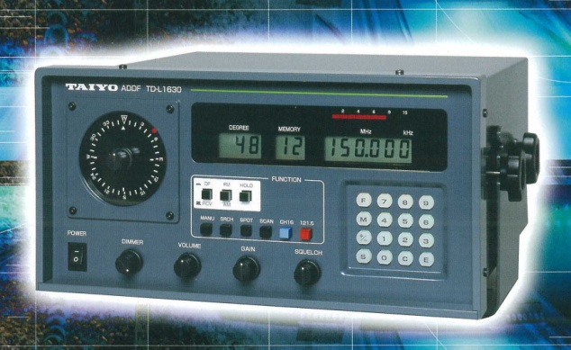
TAIYO Direction finder 1630
Frequency100-169,999MHz
Memory for 30 frequencies
One button for 121,5MHz and one button for channel 16
Digital display for direction
Circular LED display
User friendly
Included16m cable and antenna
SKIPPER Electronics AS
Enebakkveien 150
0680 Oslo
www.skipper.no
Tlf. +47 23 30 22 70
Fax +47 23 30 22 71
sales@skipper.no
support@skipper.no

Slide 23
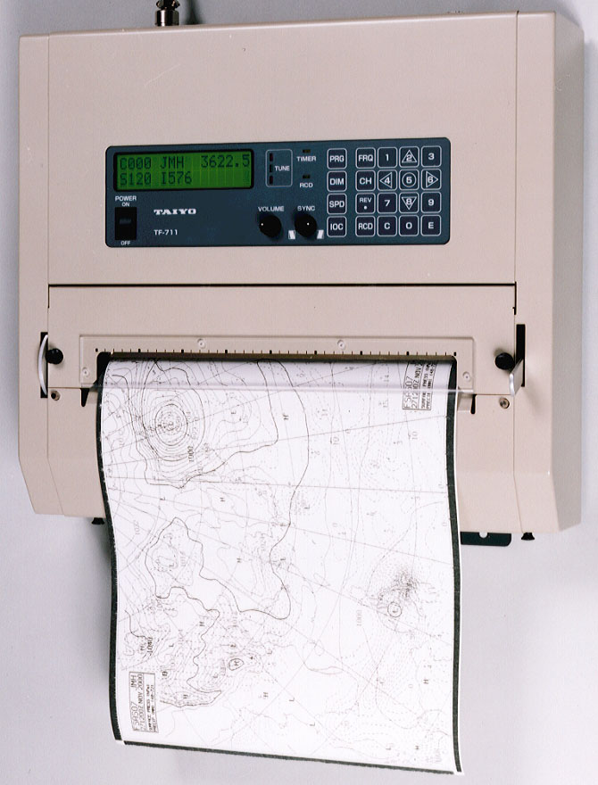
TAIYO Weather Fax TF-712
User friendly
Automatic reception
MF/HF 2.0000-24.9999MHz
16m cable and 2m antenna
SKIPPER Electronics AS
Enebakkveien 150
0680 Oslo
www.skipper.no
Tlf. +47 23 30 22 70
Fax +47 23 30 22 71
sales@skipper.no
support@skipper.no

Slide 24


Quality standards
  ISO 9001:2008
  IMO Wheelmark
  DNV/ABS/CCS
  GL/Lloyds/BV
SKIPPER Electronics AS
Enebakkveien 150
0680 Oslo
www.skipper.no
Tlf. +47 23 30 22 70
Fax +47 23 30 22 71
sales@skipper.no
support@skipper.no

Slide 25

www.skipper.no
Brochures
Certificates
Operation and installation manuals
Service data bulletins
SKIPPER news and information
Product information
Information about service agents and distributors
Service requests
HAT/SAT procedures
SKIPPER Electronics AS
Enebakkveien 150
0680 Oslo
www.skipper.no
Tlf. +47 23 30 22 70
Fax +47 23 30 22 71
sales@skipper.no
support@skipper.no

Slide 26
Contacts
SKIPPER Electronics AS
  Tlf. 23 30 22 70
  Fax. 23 30 22 71
  E-mail: sales@skipper.no
  Service: service@skipper.no
SKIPPER Electronics AS
Enebakkveien 150
0680 Oslo
www.skipper.no
Tlf. +47 23 30 22 70
Fax +47 23 30 22 71
sales@skipper.no
support@skipper.no

